Slide 1
Firm Overview
2021

Slide 2
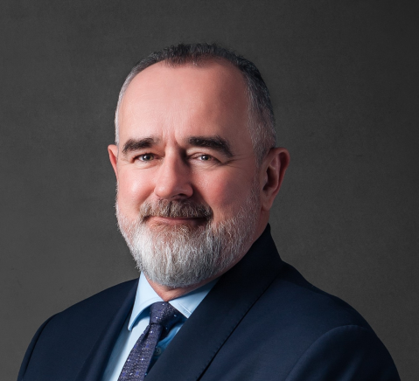
Frasers Law Company
Frasers (and its predecessor firm) have been collectively advising clients on Vietnam-related transactions for 27 years.
Frasers is consistently recognised as being in the top tier of law firms practising in Vietnam by leading independent and authoritative guides to law firms such as The Asia Pacific Legal 500 and Asialaw.
Frasers has advised leading international and Vietnamese corporations in relation to their business and investments in Vietnam, and we are regarded as being the premier independent legal practice in Vietnam. Frasers is one of the largest law firms in Vietnam with an integrated team of foreign and local lawyers.
Frasers has built up strong relationships with the Vietnamese business community and government agencies, which is particularly important given the rapidly developing Vietnamese economy and evolving legal framework.
Mark Fraser, Managing Partner
Vietnam
T: +84 28 3824 2733
E: mark.fraser@frasersvn.com

Slide 3
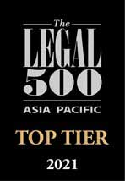
Practice recognition
Asia Pacific Legal 500 2021
Frasers Law Company is honoured to be once again recognised by The Legal 500 as being a Top Tier firm and is ranked in every possible practice area in Vietnam including:
Banking and Finance
Capital Markets
Corporate M&A
Data Protection
Dispute Resolution
Insurance
Intellectual Property
Labour and Employment
Projects and Energy
Real Estate and Construction
Shipping and Aviation
Tax
Frasers Law Company has more practising ‘Hall of Fame’ lawyers (as determined by Legal 500) than any other law firm in Vietnam.
Asialaw Profiles 2021
Frasers is also pleased to share its impressive performance in the 25th Edition of Asialaw Profiles 2021 – The Guide to the Asia-Pacific’s Leading Law Firms.
In 2021, our firm received the award for Asialaw Client Service Excellence Law Firm of the Year Vietnam in the following practice areas:
Banking and Finance
Construction
Corporate and M&A
Energy
Labour and Employment
Our Founding Managing Partner Mark Fraser was awarded Asialaw’s “Client Service Excellence Lawyer of the Year – Vietnam” in 2020.

Slide 4
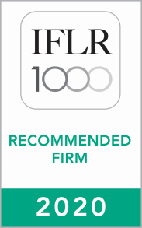
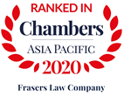
Practice recognition
Chambers Asia Pacific 2020
The publication has ranked Frasers Law Company in numerous practice areas, especially in the following:
Banking and Finance
Corporate M&A
Dispute Resolution: International Arbitration
Projects, Infrastructure and Energy
Intellectual Property
Tax
IFLR1000 2020
We are repeatedly ranked among the leading law firms in Vietnam in the IFLR1000 guide in the following practice areas:
Banking and Finance
Capital Markets: Debt
Capital Markets: Equity
Corporate M&A
Project Development
Benchmark Litigation 2020
Frasers is ranked a “Recommended Firm” in the Benchmark Litigation 2020 edition.
Frasers received a “Vietnam Firm of the Year” nomination in the Benchmark Litigation 2020 Awards.
Mark Fraser was nominated for “Vietnam Lawyer of the Year” in the Benchmark Litigation 2020 Awards.

Slide 5
Practice recognition
ALB Super 50 TMT Lawyers 2021
ALB Super 50 TMT Lawyers 2021 list spotlights the most highly recommended TMT practitioners based permanently in the Asian region.
The list will showcase the top 50 lawyers who are doing high-quality work, and in the process earning accolades from their colleagues, superiors and clients.
Frasers has been selected for the ALB Super 50 TMT Lawyers, a listing which will be published in the August 2021 issue of ALB Asia.

Slide 6
Core Practice Areas
Corporate and Commercial
Corporate Fraud
ESG (Environmental Social and Governance)
Banking and Finance
Capital Markets
Competition and Antitrust
Dispute Resolution
Employment
Insurance
Intellectual Property
International Trade
Investigations
Mergers and Acquisitions
Project Finance
Projects and Energy
Real Estate
Regulatory Compliance
Restructuring and Insolvency
Tax
Technology, Media and Telecommunications

Slide 7
Key Industry Sectors
Banking and Finance
Capital Markets and Securities
Education
Employment and Human Resources
Equitisations
FMCG
Healthcare and Pharmaceuticals
Investment Funds
Insurance
IT, Media and Telecoms
Manufacturing
Energy
Projects and Infrastructure
Real Estate and Construction
Retail
Transportation and Logistics
Travel, Hospitality and Tourism

Slide 8
Ho Chi Minh City Office
Unit 19.01, 19th Floor, Deutsches Haus
33 Le Duan Boulevard,
District 1, Ho Chi Minh City
Phone +84 28 3824 2733
Fax +84 28 3824 2736
Hanoi Office
Unit 1205, 12th Floor, Pacific Place
83B Ly Thuong Kiet Street Hoan Kiem District , Hanoi
Phone +84 24 3946 1203
Fax +84 24 3946 1214
E-mail: legalenquiries@frasersvn.com
www.frasersvn.com

